Slide 1
Summer internship report Android application for resistor value detection
Opra István Balázs
Consultant:
Michèle Gouiffes

Slide 2
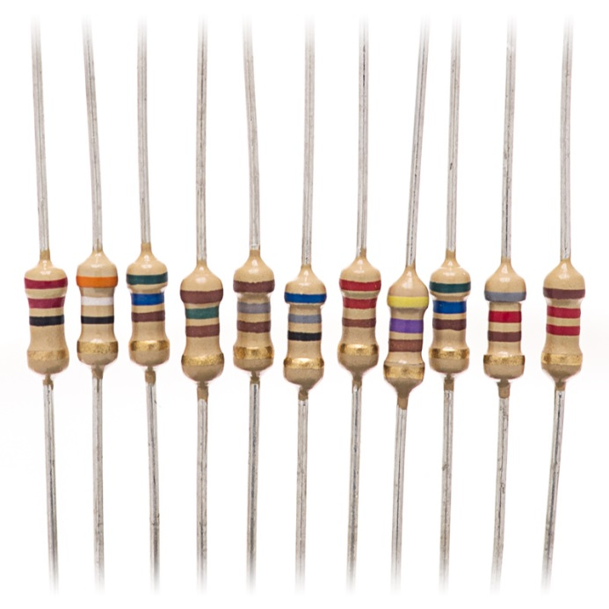
Overview
The task: create a smarthphone application which can substitute a multimeter for TH resistors by using the device’s camera
Can find resistor
Can detect colored bands
Works faster than a multimeter
This application would be used by students attending laboratory courses

Slide 3
Resistor color codes
Through-hole resistors values are coded by the colored bands on the resistors’ body
Learning the color code takes time
Colorblind people are left with Ohm-meters
Electronic measurement may be impossible in-circuit
No reliable app exists for this task yet

Slide 4
Starting out - Matlab
Development will be a trial-and-error procedure
Powerful, easy to use environment is needed
Our choice: Matlab with Image Processing Toolbox
The Android app is based on the Matlab code: I will describe the algorithm based on that

Slide 5
Finding the resistor
A homogenous background is assumed
It helps if it’s low saturation
RGB -> HSV, then thresholding of S channel -> one binary mask
Another binary mask by application of Sobel operator, and thresholding the result
Morphological closing (fill in gaps) then opening (remove noise spots)

Slide 6
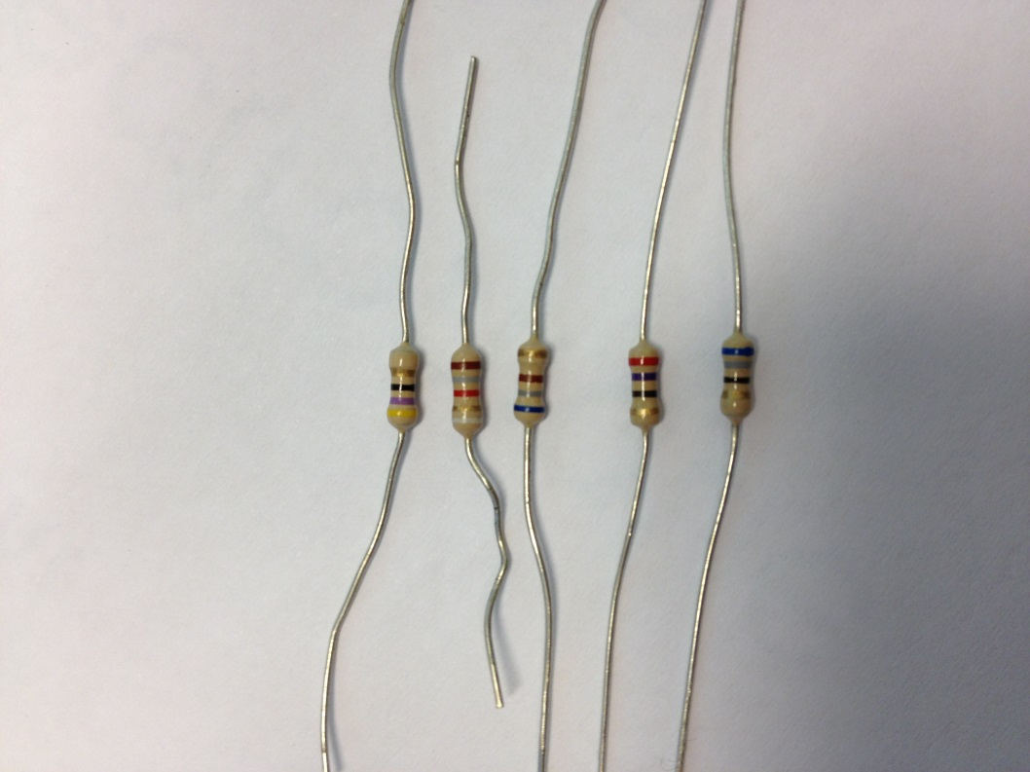
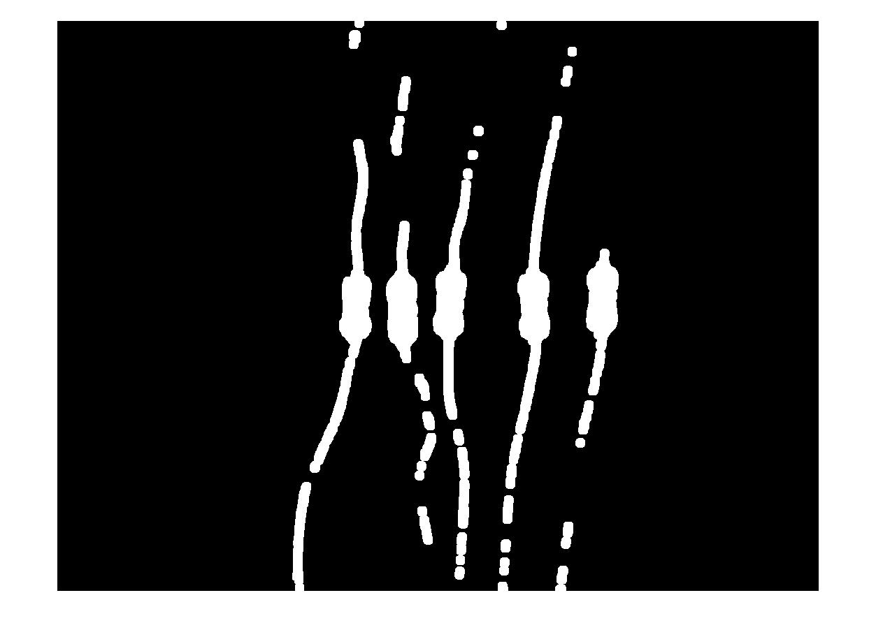
Finding the resistor
Then, logical AND of the two masks. Result:

Slide 7
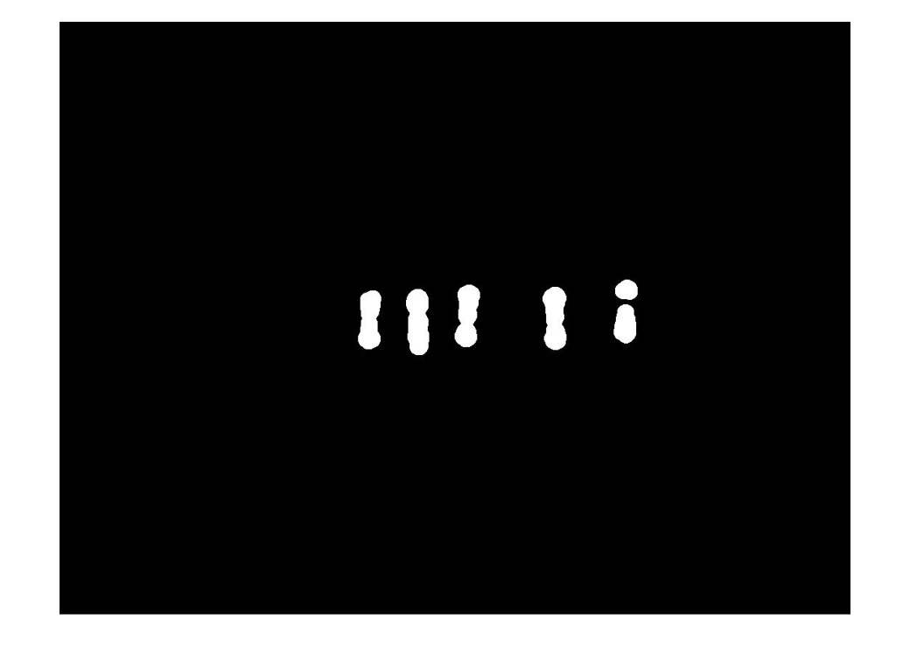

Removing the wires
By ultimate erosion: erode, while keeping the result of each step in memory
When nothing remains, go back in memory to an image, where only resistor body pixels are present
Regrow with dilatation

Slide 8
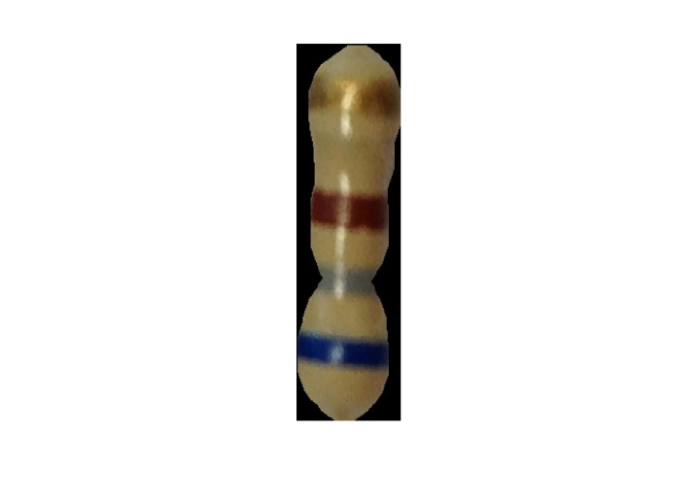
Masking
In Matlab, connected component labeling, then selection of a single resistor body
Application of the mask as binary AND, and cropping:

Slide 9
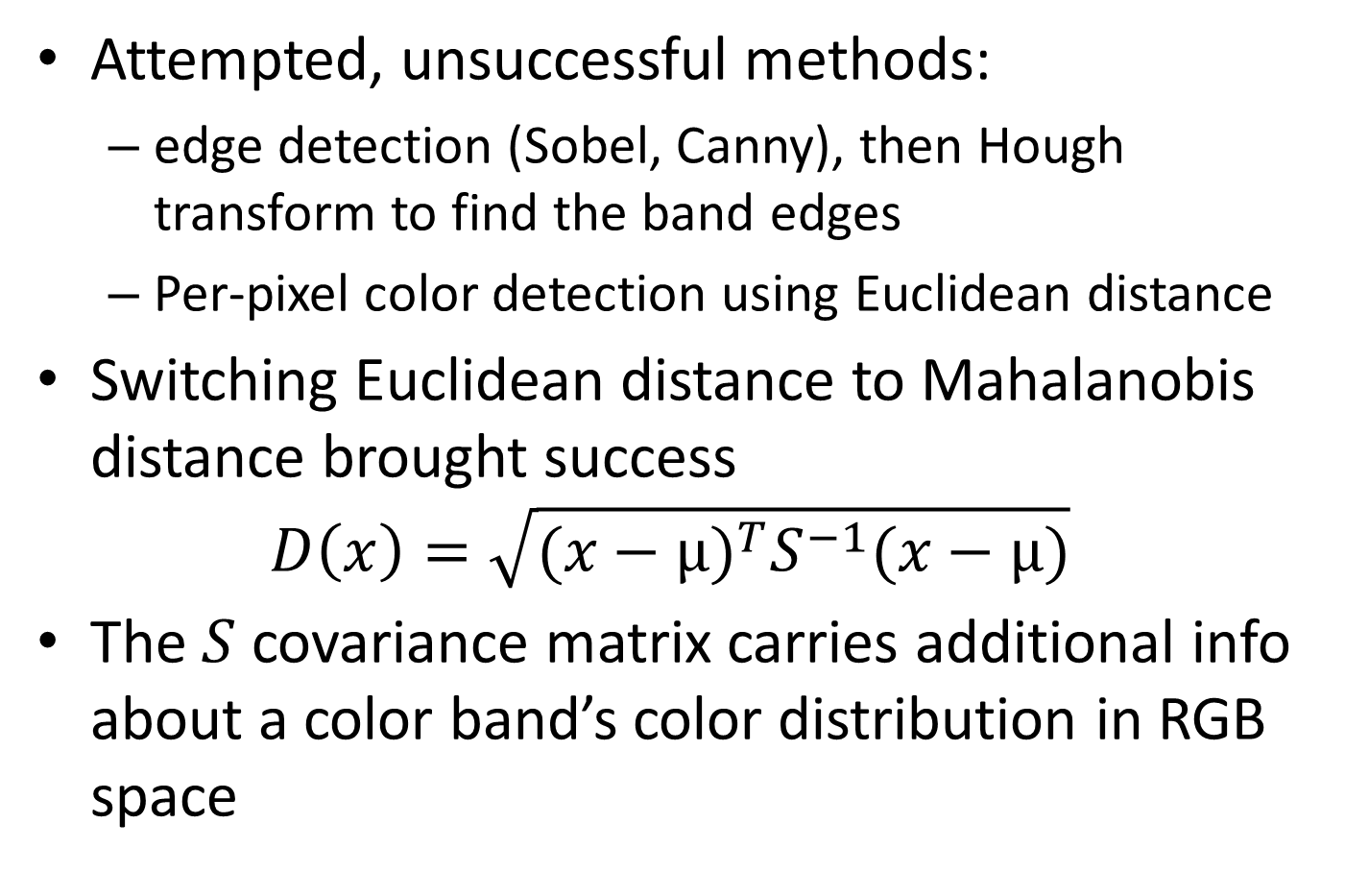
Detection of color bands
Attempted, unsuccessful methods:
edge detection (Sobel, Canny), then Hough transform to find the band edges
Per-pixel color detection using Euclidean distance
Switching Euclidean distance to Mahalanobis distance brought success
$$D\left(x\right)=\sqrt{{(x−μ)}^{T}S^{−1}(x−μ)}$$
The $S$ covariance matrix carries additional info about a color band’s color distribution in RGB space

Slide 10

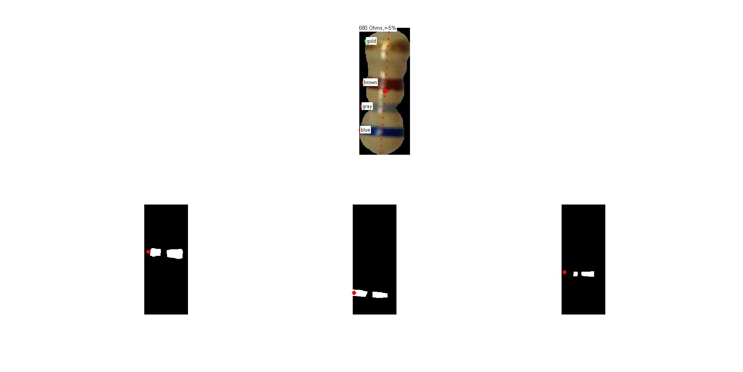
Detection of color bands
Mahalanobis distance from all ten possbile colors is calculated
If a pixel is closer to a color than threshold it is marked in a binary mask
Morphological opening is used on these masks afterwards

Slide 11
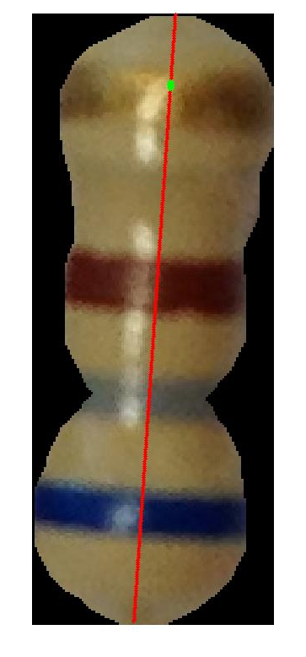
Detection logic
Centroids of blobs on the masks are calculated
Then they are projected to a line which is parallel with the main axis of the bounding ellipse of the resistor body mask

Slide 12
Detection logic
If a band is detected as multiple blobs, they are merged into one
The red dots are the end result:

Slide 13
Gold and silver bands
They pose a different problem
Their color is not homogenous (both in chromaticity and intensity) – strong highlight
Pixel-based attempts to detect them were in vain
A somewhat reliable solution was reached by region-based analysis
Only gold bands were tested so far

Slide 14
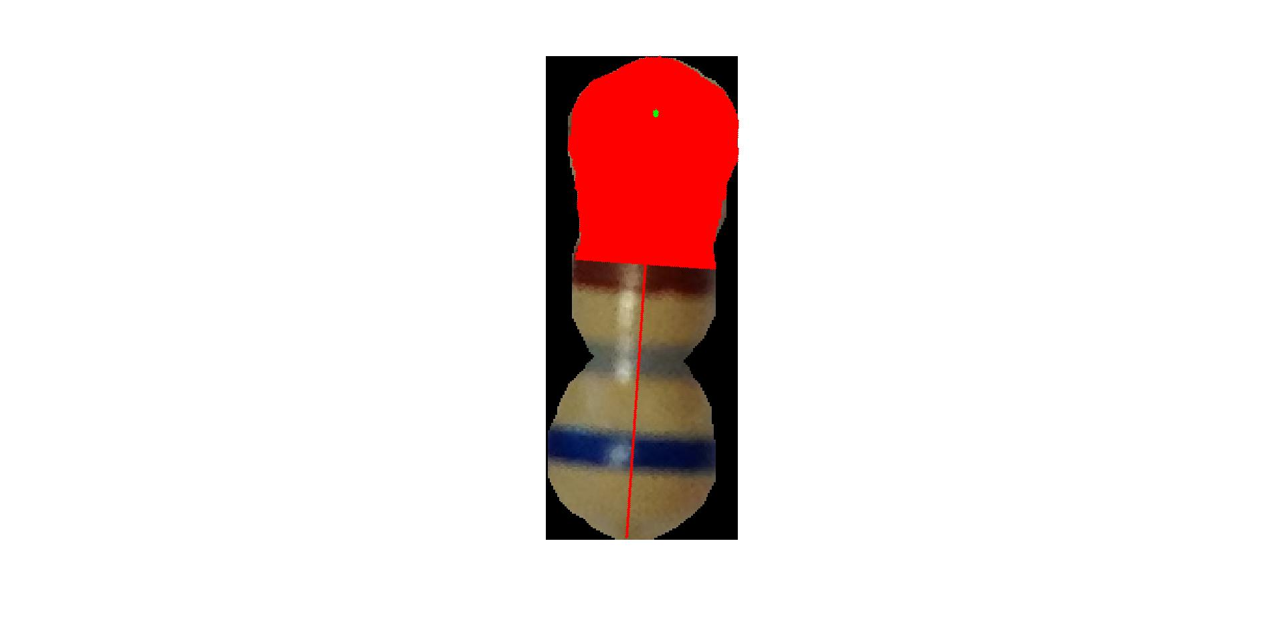
Gold bands
After solid colors are detected, gold band detection starts if there’s a possibility of its existence
Groups of pixels are sampled along the main axis
After a step on the main axis, pixels are gathered in a line perpendicular to it

Slide 15
Gold bands
Gathered pixels are stored in a FIFO-like buffer
After each step on the main axis, evaluation takes place:
A covariance matrix is calculated from the contets of the FIFO buffer (3x3 for RGB)
A pre-compiled gold covariance matrix is substracted from this, and the 2-norm of the result is calculated, then normalised
The result is a score function giving information on how gold-like is a spot along the main axis

Slide 16
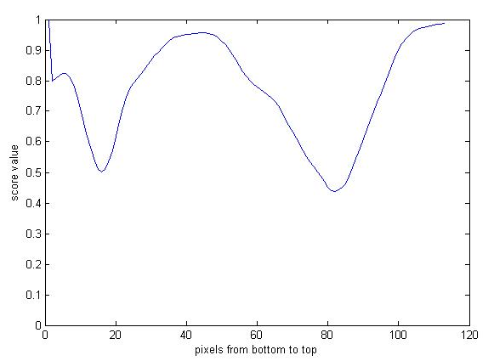
Gold bands
If a given spot’s score is lower than threshold, it is considered gold
If there are a few consectutive pixels like that, a gold band is detected

Slide 17
Result
After the bands are identified as neat spots along a line, resistor value calculation is relatively straightforward

Slide 18
Android application
The android application’s operation is largely based on the previously detailed sequence
To start detection, the user has to tap on the resistor
Thus, no connected component labeling is done, the program focuses on the tapped-on area to find a single resistor

Slide 19
Android application
Algorithm was heavily dependent on lighting conditions
New addition: white balance correction
A white object is needed to set the balance ratios
Perceived white is then upscaled to a standard intensity white co
Result: improved invariance to bakground lighting color

Slide 20
Android application
Weaknessess:
Resistor body detection
Shadows
Low light environment
Many operations are done using OpenCV
Interesting detail: the Mahalanobis distance calculation is done on the GPU with the use of OpenGL ES – this improves speed immensely
Please observe a short „stage demo!”

Slide 21
Thank you for your attention!

